Slide 1
CIV 257- COMPUTER PROGRAMMING
Lecture 2
CIVIL AND GEOMATIC ENGINEERING
FT Okyere.

Slide 2
Expressing and executing algorithms
Expressing and executing algorithms
To express algorithms we use a programming language which is a means to write down
the instructions of an algorithm in a form that allows:
– Humans to write and read them (a means of communication between people)
– A machine to execute the instructions without further human intervention (we do not have to further explain the steps to the machine)
A computer is seen in the context of computer programming learning as an algorithm execution machine. A computer system provides support to get information in and out in a form useful to humans.

Slide 3
Creation of algorithms
• Algorithms are created by your ingenuity
• Creativity
• Computers languages and computers are just a means to express and execute algorithms.
They are like the paint and canvas, not the art. The algorithm is the art.

Slide 4
Principles of expressing algorithms
When we write algorithms we need a way to:
1. Name both data and algorithms in a way that is unambiguous, flexible and easy to
understand
2. Store and retrieve data using names and other identifying information
3. Operate on data using names and literal values (For example, 1, 1.414 and "string" are literal values.)
a. multiply numbers, add letter to word, display image

Slide 5
Principles of expressing algorithms
4. Apply an algorithm to data, both identified by name
5. Denote the order of operations
6. Express choice based on the data
a. if this, then do that, otherwise do something else
7. Express repetition
− repeat this task 1,000,000 times

Slide 6
Flow Charts
A flow chart is a diagram of the sequence of operations in a computer program.
The steps the algorithm must take are shown as boxes. The boxes are connected by arrows to show the order in which the steps follow.
Flow charts are used in designing, analysing, in other fields of study

Slide 7
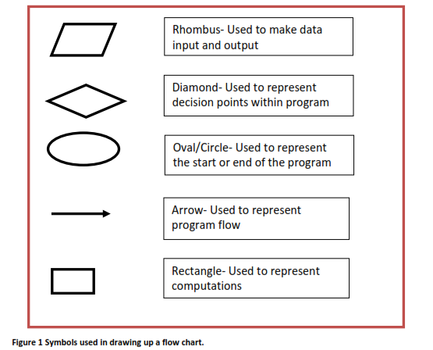

Slide 8
Flow Charts
Start and end symbols -circles, ovals or rounded rectangles usually
containing the word “start” or “end” or the equivalent.
Flow of the program is =arrow symbol.
An arrow coming from one symbol and ending at another symbol represents that control passes to the symbol the arrow points to.
Processing steps =rectangles containing information about the process (example, “add text”).
A condition or decision are represented as diamond (call it rhombus). These typically contain a Yes/No question or True/False test. It has two arrows coming in and out. The arrows are labelled as appropriate.
The symbols should be labelled by writing a description of its function within the appropriate box.

Slide 9
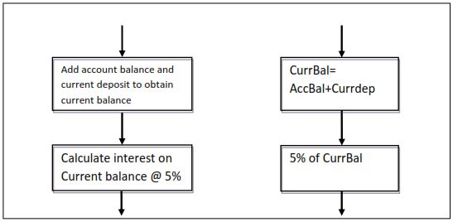
Algorithm Example
An arithmetic sum of two numbers, current deposit and account balance to obtain the current balance.
We then compute the 5% interest of the currbal.

Slide 10
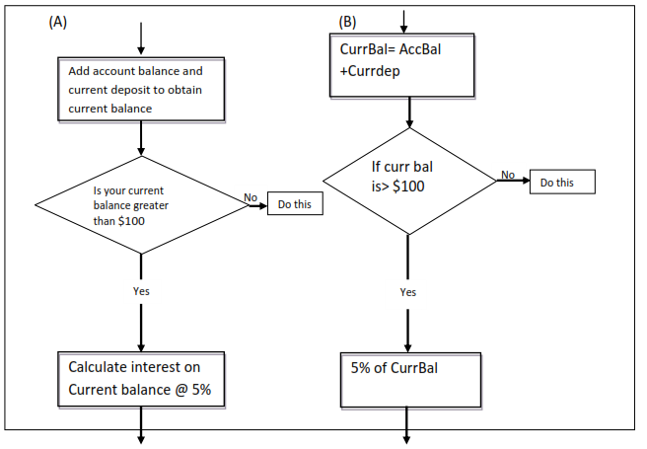
Flow Charts- Example

Slide 11
Flow Charts- Example
Diagram A and B are the same except; Diagram A is cumbersome because complete
Words have been used in describing the function of boxes whiles Diagram B uses shorthand way of representing the algorithm also known as pseudocode(A notation resembling a simplified programming language, used in program design). For example curr for current, bal for balance and Acc for Account.
Computation of the sum of two numbers, current deposit and account balance respectively to give the current balance.
Decision on whether to calculate interest of 5% on the current balance or do something else. ????
❖ Computation of 5% interest if the decision is ‘Yes’ current balance is greater than $100

Slide 12
Important Note
No Handout No Score 30%
?Because
Thievery cannot be rewarded!
Fresh Juice costs 10 cedis!
75% Attendance or No Exams- check Student handbook!
Dare and meet me again June 2013, lets start over again…

Slide 13
COMPUTER PROGRAMMING PARADIGMS or CONCEPTS
Objects and Classes
Assemblies
Forms as objects
Setting and retrieving properties
Variables
  Scalar
  Array
Datatypes
Repetition, conditional statements
Functions(Procedures or subroutine)
Assigment

Slide 14
OOP AND Visual Basic Concepts
There are two main computer programming paradigms;
Procedural programming and the Object-Oriented Programming (OOP).
A procedural programming language provides a programmer a means to define precisely each step in the performance of a task.
Object Oriented Programming (OOP) is all about writing programs that manipulate objects. Object-oriented programming is a programming paradigm that uses "objects" – data structures consisting of datafields and methods together with their interactions – to design applications and computer programs.
VB, Delphi, along with C++ and Java, are fully object oriented languages.

Slide 15
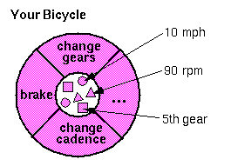
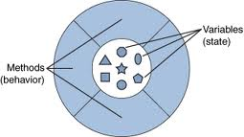
COMPUTER PROGRAMMING PARADIGMS or CONCEPTS
What Is an Object?
An object is a software bundle of related state and behavior. Software objects are often used to model the real-world objects that you find in everyday life.

Slide 16
COMPUTER PROGRAMMING PARADIGMS or CONCEPTS
Classes and Objects
The terms class and object are sometimes used interchangeably, but in fact, classes describe the structure of objects, while objects are usable instances of classes.
Each instance is an exact yet distinct copy of its class. Because an object is an instance of a class, the act of creating an object is called instantiation.
blueprints describe the items that form buildings

Slide 17
COMPUTER PROGRAMMING PARADIGMS or CONCEPTS
The four principles of object oriented programming:
• Abstraction
• Encapsulation
• Inheritance
• Polymorphism
Visual basic has evolved to become an object oriented language.

Slide 18
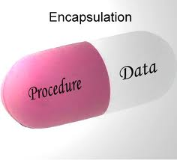

COMPUTER PROGRAMMING PARADIGMS or CONCEPTS
Encapsulation means that a group of related properties, methods(procedure), and other members are treated as a single unit or object.
Abstraction is achieved through encapsulation. Abstraction means to generalize or conceptualise

Slide 19
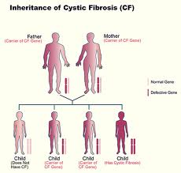
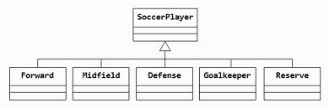
COMPUTER PROGRAMMING PARADIGMS or CONCEPTS
Inheritance describes the ability to create new classes based on an existing class.
The new class inherits all the properties and methods and events of the base class, and can be customized with additional properties and methods.
class libraries can be purchased

Slide 20
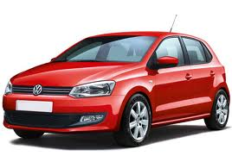
COMPUTER PROGRAMMING PARADIGMS or CONCEPTS
For example, you can create a new class named "Truck" based on the "Car" class.
The "Truck" class inherits the "Colour“ property from the "Car" class and can have additional properties such as
"Four WheelDrive.“
Polymorphism is the concept that different objects have different implementations of the same characteristic. For example, consider two objects, one representing a Porsche 911.
4matic
2matic

Slide 21
Assemblies
Assemblies are the most common source of objects for Visual Basic applications. The .NET Framework (as in Visual Basic.NET in MS VS 2005, 2008, 2010) includes assemblies that
contain commonly used objects.
Intrinsic objects
Extrinsic objects (use imports statement)

Slide 22

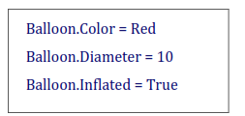

Properties
In Object Oriented programming we treat statements representing instructions as objects
as explained above. Scientifically, objects or materials have properties. For example, a balloon
Notice the order of the code- the object (Balloon),period, followed by the property (Colour),
followed by the assignment of the value (= Red). You could change the balloon's colour by
substituting a different value.

Slide 23

Properties of objects
Properties you can set and read are called read-write properties. Properties you can read but not modify are called read-only properties. Properties you can write but not read are called write-only properties.
You set the value of a property when you want to change the appearance or behaviour of an object. For example, you change the Text property of a text box control to modify the contents of the text box.
Read-only
Read-and-write

Slide 24
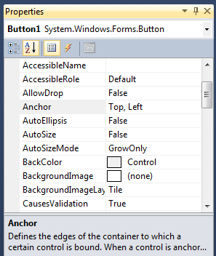
How to: Set and Retrieve Properties
When working with forms and controls in Visual Basic, you can set their properties programmatically at run time (i.e. within the program), or you can set them in design mode using the Properties window.
The properties of most other objects, such as objects from assemblies or objects you create, can only be set programmatically.
E.g design mode and program’ty
Button1.Anchor = AnchorStyles.Top
Button1.Anchor = AnchorStyles.Left

Slide 25
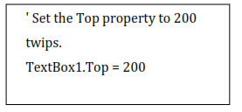
How to: Set and Retrieve Properties
To set property values
Use the following syntax:
Object.property = expression
The following statements provide examples of how to set properties in Visual Basic:

Slide 26

How to: Set and Retrieve Properties
To get property values
Use the following syntax:
Variable = Object.property
You can also get a property value as part of a more complex expression, without assigning
the property to a variable. The following code changes the Top property of a radio button
control:
i=i+1 is same as i+=1
x=x+1 is same as x+=1

Slide 27
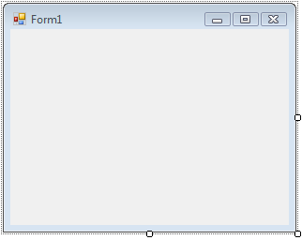
Forms as Objects
Forms are graphical objects that make up your application's user interface.

Slide 28
Forms as Objects
Forms are graphical objects that make up your application's user interface.
Within VisualBasic, classes define how forms are displayed and what they can do.
Syntax:
Public Class Form1
Public Sub PrintMyJob()
' Insert the code for your method here.
End Sub
End Class

Slide 29
Forms as Objects
Public sub createnewform()
Dim newForm1 As New Form1
newForm1.show()
End sub
The above code create a new form object called newForm1 and displays it.

Slide 30
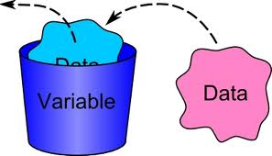
Variable Naming
Variables
A variable is a convenient placeholder that refers to a computer memory location where you can store program information that may change during the time your script is running.
For example, you might create a variable called ClickCount to store the number of times a user clicks an object on a particular Web page.
Where the variable is stored in computer memory is unimportant. What is important is that you only have to refer to a variable by name to see or change its value. In VBScript,
E.g temp=1, temp is the variable

Slide 31
Variable Naming
Declaring Variables
You declare variables explicitly in your script using the Dim statement, the Public
statement, and the Private statement. For example:
Dim DegreesFahrenheit - Dimensions DegreesFahrenheit as variable whose data type is not declared.
Public myStr as string – Dimensions the variable myStr as a string in memory during run time
Any time the program runs and comes to this line

Slide 32
Variable Naming Restrictions
Name variables in a way that make sense to another user of your program.
The variable name should suit the variable it represents.
You can start the name with a lower case abbreviation that tells which container or object the variable is stored in, followed by a description of the variable.
Example is ‘txtTax’. This variable stores its value in a textbox
(abbreviated as txt) and stores an amount of tax.
cmd- command button
lbl- label. etc

Slide 33
Variable Naming Restrictions
Variable names follow the standard rules for naming anything in VBScript. A variable name:
Must begin with an alphabetic character. (E.g. 1vol is not a good variable name but vol is
Cannot contain an embedded period. (vol.1 is not a good variable name but Vol1 is

Slide 34
Variable Naming Restrictions
Must not exceed 255 characters. (keep variable names considerably simple but meaningful)
thisisMyvariableanditisverylong
Must be unique in the scope in which it is declared.

