Slide 1
CIV 257- COMPUTER PROGRAMMING
CIVIL AND GEOMATIC ENGINEERING
FT Okyere.

Slide 2
Notes
No Mobile Phone!
No coming in late
All assignments submitted on time
No attitude
Crime to photocopy Lecture Notes!

Slide 3
Delphi and Visual Basic Programming:
Visual Basic concepts,
Designing programs,
Program Flow,
Testing and Debugging,
Functions,
Arrays, Interacting with the user, Interacting with the system;

Slide 4
What is Computer programming?
Writing a set of instructions,
Testing these in a certain programming language,
Debugging or troubleshooting, and
Maintaining the source code of the resultant programs.
A program is written to solve a specific problem
E.g. Engineering Problems, General Scientific and Business Problems

Slide 5

Earlier Developments
One of Al-Jazari's robots was originally a boat with four automatic musicians that floated on a lake to entertain guests at royal drinking parties.
The Jacquard
Loom, which Joseph Marie Jacquard developed in 1801, uses a series of pasteboard cards with holes punched in them. The hole pattern represented the pattern that the loom had to follow in weaving cloth.

Slide 6
Some History
Development of computer programming accelerated through the Industrial Revolution.
1850-1950
In the late 1880s, Herman Hollerith invented the recording of data on a medium that could then be read by a machine

Slide 7
Some History/Background
The invention of the Von Neumann architecture allowed computer programs to be stored in computer memory.
Early programs had to be painstakingly crafted using the instructions of the particular machine, often in binary notation.
01010101101010101010110101101101101010110101010101010110101

Slide 8
Some History/Background
Every model of computer would be likely to need different instructions to do the same task.
Later assembly languages were developed that let the programmer specify each instruction in a text format, entering abbreviations for each operation code instead of a number and specifying addresses in symbolic form (e.g., ADD X, TOTAL).

Slide 9
Some History/Background
In 1954 Fortran was invented,
being the first high level programming language to have a functional implementation. It
allowed programmers to specify calculations by entering a formula directly (e.g. Y = X*2 +
5*X + 9).

Slide 10
Programming Languages
Fortran Basic Visual C++
Jsharp C# Visual Basic
Delphi C++ Java
Etc

Slide 11
Programming Languages
Different types of programming languages work well in certain problem- solving
environments. For example Fortran is often used in engineering applications. Whiles Java
is almost ubiquitous in web programming environments, and most websites you have
visited have made use of the java programming language. C is used in embedded
applications (applications). Expert knowledge is usually required in order to make a choice

Slide 12
Qualities of A Good Programme
Efficiency/performance: the amount of system resources a program consumes (processor time, memory space, slow devices such as disks, network bandwidth and to some extent even user interaction):
Reliability: how often the results of a program are correct.
Robustness: how well a program anticipates problems not due to programmer error- data entry etc.
Usability: the ease with which a person can use the program for its intended purpose or more
Portability- range of computer hardware and operating system platforms

Slide 13
Algorithmic Problem solving
An algorithm is a finite list of instructions describing how to transform information from
inputs into outputs. There must be a machine that can execute these instructions. The
execution of the final program must terminate in finite time. Algorithms can be defined without reference to transforming information. This means the instructions should be
simple enough such that each step can be done without thinking about it.

Slide 14
Algorithmic Problem solving- Example
E.g. Algorithm to meet Friend at Airport
Step 1: Take a Bath and dress
Step 2: Get a Taxi to Airport
Step 3: Alight
Step 4: Wait
Step 5: If Friend has arrived goto step 6 else
Goto step 4
Step 6: Get a Taxi Home

Slide 15
Expectations of computer algorithms
1. Finite list
2. Mechanistic Execution
3. Finite Execution

Slide 16
Understanding the programming process
A programmer’s job involves writing instructions, but does not just start typing at the
keyboard. There are six programming steps:
1. Understand the problem
Programmers write programs to satisfy the needs of others. For example: the Human
Resources Department that needs a printed list of all employees, the Billing Department
that wants a list of clients who are 30 or more days overdue.
2. Plan the logic

Slide 17
The six programming steps:
The heart of the programming process lies in planning the program’s logic. During this
phase of the programming process, the programmer plans the steps to the program,
deciding what steps to include and how to order them. You can plan the solution to a
problem in many ways. The two most common tools are flowcharts and pseudocode.

Slide 18
The six programming steps:
3. Code the program
Once the programmer has developed the logic of a program, only then can he or she write the program in one of more than 400 programming languages. Programmers
choose a particular language because some languages have built-in capabilities that make
them more efficient than others at handling certain types of operations.

Slide 19
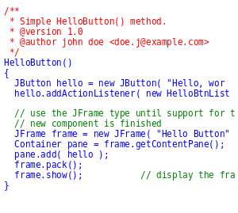
Code

Slide 20
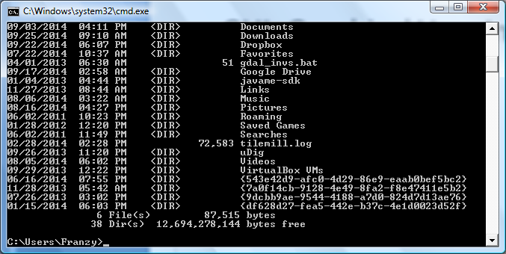
GUI- Command line

Slide 21
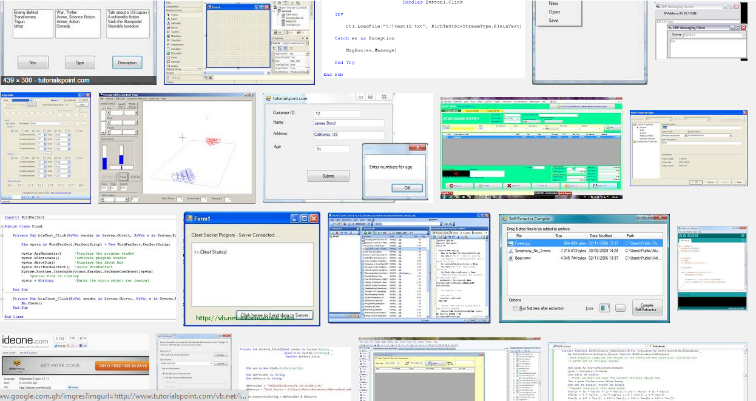
GUI- Graphical User Interface

Slide 22
The six programming steps:
4. Translate the program into machine language
Languages like Java or Visual Basic are available are available for programmers to use
because someone has written a translator. Program (a compiler or interpreter) that
changes the English-like high-level programming language in which the programmer
writes in to the low-level machine language that the computer understands.

Slide 23
The six programming steps:
5. Test the Program
A program that is free of syntax errors is not necessarily free of logical errors. Once a
program is free from syntax errors, the programmer can test it- that is, execute it with
some sample data to see whether the results are logically correct.

Slide 24
The six programming steps:
6. Put the program to production
Once the program is tested adequately, it is ready for the organization to use.
Running the program once, if it was written to satisfy a user’s request for a special list.
However, the process might take months if the
program will be run on a regular basis, or if it is one of a large system of programs being developed. An organization for which a program is written for would have to make some adjustments, in terms of data and users which may take from a few hours to several months, depending on the size of the project for which the program was written.

